Slide 1
Weekly report: Team Project Development
Week number: 05
Date: 26/10/2025
Supervisor: Dr. Marina Blohm
Group members: Luis Urhahn, Ahmed Sallam, Ceren Cetin, Sohail Mansuri
Presenter: Luis Urhahn

Slide 2
List of content
Task of this week
Further update on wind analysis – Weibull-Distribution
Overview sub-tasks
Progress of the tasks
Detailed Site Analysis
WindPro Simulation
Economic calculation (LCOE)
Updated timeline
Questions and Requests
Luis Urhahn

Slide 3
1. Tasks of the week
Optimizing/Updating the Weibull-Distribution
Working and progressing the sub-tasks
Detailed site analysis
WindPro Simulation
Economic calculation (LCOE)
Luis Urhahn

Slide 4
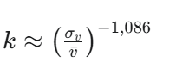
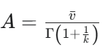
2. Update on wind analysis (HH = 100m)
Wind range [m/s] | Windbins [m/s] | Absolute Frequency (n_i) | Cumulative Distribution Function F(v) | Probability Density Function f(v)
0 - 1 | 0.5 | 154 | 0.00293 | 0.022910994
1 - 2 | 1.5 | 1863 | 0.03544 | 0.047745282
2 - 3 | 2.5 | 3652 | 0.06948 | 0.06430642
3 - 4 | 3.5 | 4805 | 0.09142 | 0.075101365
4 - 5 | 4.5 | 4736 | 0.09010 | 0.081127619
5 - 6 | 5.5 | 4180 | 0.07953 | 0.08316111
6 - 7 | 6.5 | 3796 | 0.07222 | 0.08194524
7 - 8 | 7.5 | 3353 | 0.06379 | 0.078210087
8 - 9 | 8.5 | 2975 | 0.05660 | 0.072651867
9 - 10 | 9.5 | 2856 | 0.05434 | 0.065906216
10 - 11 | 10.5 | 2746 | 0.05224 | 0.0585264
11 - 12 | 11.5 | 2691 | 0.05120 | 0.050970001
12 - 13 | 12.5 | 2550 | 0.04852 | 0.043594435
13 - 14 | 13.5 | 2343 | 0.04458 | 0.036660096
14 - 15 | 14.5 | 2134 | 0.04060 | 0.030339248
15 - 16 | 15.5 | 1831 | 0.03484 | 0.024728617
16 - 17 | 16.5 | 1566 | 0.02979 | 0.019863793
17 - 18 | 17.5 | 1319 | 0.02509 | 0.015733853
18 - 19 | 18.5 | 1078 | 0.02051 | 0.012295033
19 - 20 | 19.5 | 753 | 0.01433 | 0.009482683
20 - 21 | 20.5 | 477 | 0.00908 | 0.007221106
21 - 22 | 21.5 | 332 | 0.00632 | 0.005431172
22 - 23 | 22.5 | 204 | 0.00388 | 0.004035826
23 - 24 | 23.5 | 96 | 0.00183 | 0.002963737
24 - 25 | 24.5 | 35 | 0.00067 | 0.002151412
25 - 26 | 25.5 | 28 | 0.00053 | 0.00154413
26 - 27 | 26.5 | 8 | 0.00015 | 0.001096003
27 - 28 | 27.5 | 0 | 0.00000 | 0.00076947
28 - 29 | 28.5 | 0 | 0.00000 | 0.000534444
29 - 30 | 29.5 | 0 | 0.00000 | 0.000367296
30 - 31 | 30.5 | 0 | 0.00000 | 0.000249806
Parameter | Unit | Number
Number of Measurements | / | 52560
Mean value (v_bar) | m/s | 8.49
standard deviation (sigma_v) | m/s | 5.1399
Ratio | / | 0.6054
Form Parameter (k) | / | 1.7246
Gamma-Argument | / | 1.5798
Gamma-Value | / | 0.8914
Scale Parameter (A) | m/s | 9.52
Form Parameter:
Scale Parameter:
[5] [6] [7]
Luis Urhahn

Slide 5
2. Weibull-Distribution
[5] [6] [7]
Luis Urhahn

Slide 6
3. Overview of the sub-tasks
Detailed Site-Analysis
Legal framework
QGIS Analysis
WindPro Simulation
Project setup
Wind Resource Implementation
Economic Calculation (LCOE)
Tool setup
Environmental Impact Assessment (EIA)
Transportation study
Grid connection plan
(Land leasing)
(Conflict of Interests)
Layout Design
Compliance Optimization
Final Calculation
Collecting all the input parameters (component costs)
Including the AEP
Calculating the LCOE
Luis Urhahn

Slide 7
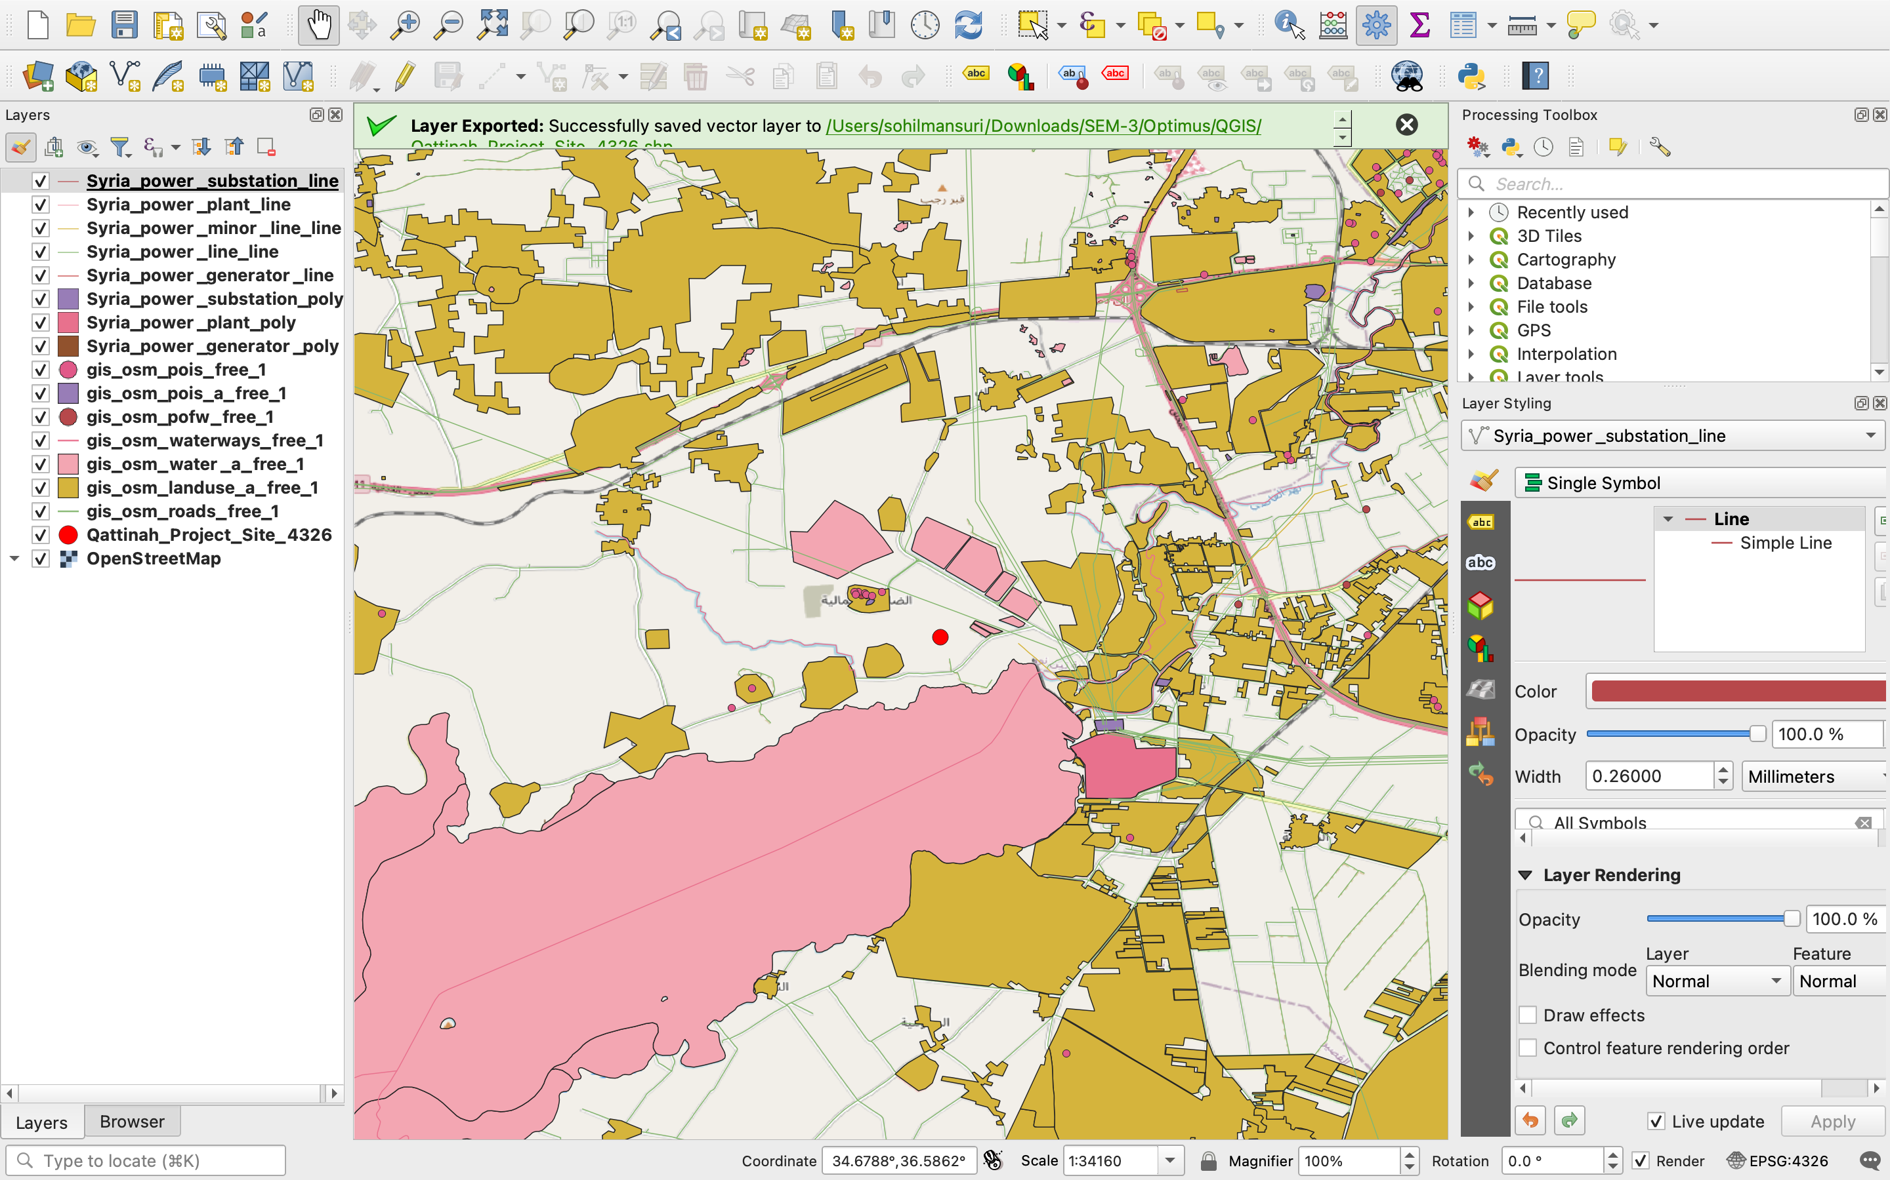
4.i Progress: Detailed Site Analysis
Figure 1: Overview of the QGIS “White Mapping” Progress [9]
Luis Urhahn

Slide 8
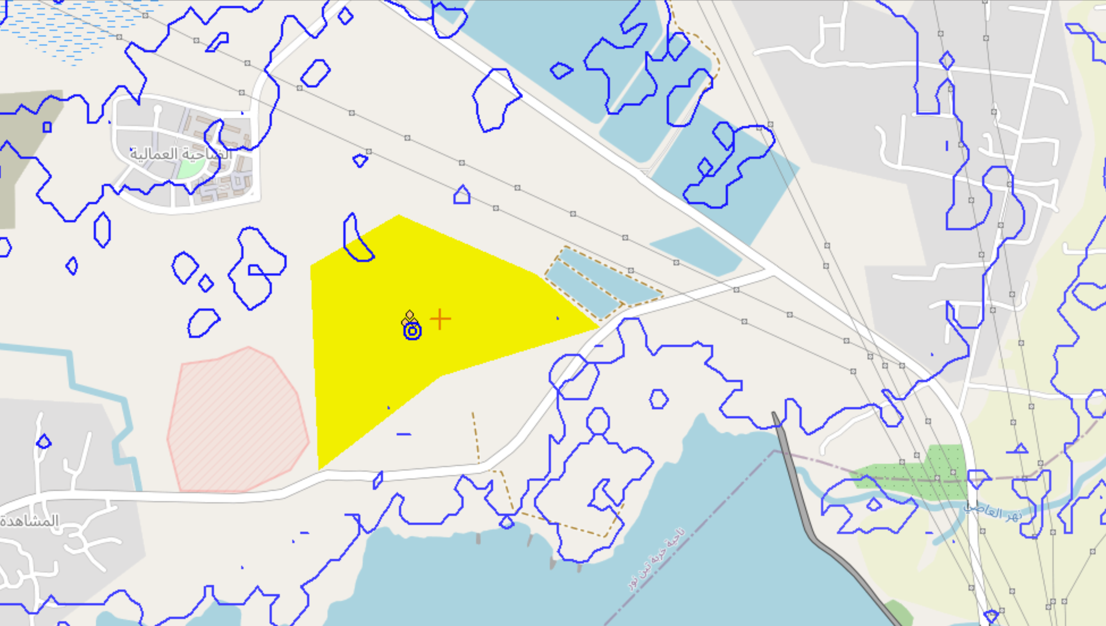
4.ii Progress: WindPro Simulation
Set-up of the WindPro model:
Set-up of site location
Creating the WTG area
Defining the Orography
Defining the Roughness
Figure 2: Screenshot from the WindPro Simulation [8]
Luis Urhahn

Slide 9
4.iii Progress: Economic Calculation (LCOE)
Actual electricty price in syria
12 cent and 30 cent per kWh or higher depend on actual gas price market .
Worldwide LCOE for Wind turbine
Pay back period
Interest rate
Work plan for LCOE
Wind Electricity Purchase Price (Tariff)
BOQ (Bill of Quantity)from all teams
Discount rate determination
Setting a target value for LCOE
Calculating the NPV (net present Value )
Make a sensitivity analysis
Determine our cost drivers
Prepare a full calculated excel sheet for cost analysis year by year
Equity to dept ratio
Possible incentives
Luis Urhahn

Slide 10
5. Timeline – Project Development Team
 | Milestone Plan of Team "Project Development"
Description | OCT |  |  |  |  |  |  |  |  |  |  |  |  |  |  |  |  |  |  |  |  |  |  |  |  |  |  |  |  |  |  | NOV |  |  |  |  |  |  |  |  |  |  |  |  |  |  |  |  |  |  |  |  |  |  |  |  |  |  |  |  |  | Dec |  |  |  |  |  |  |  |  |  |  |  |  |  |  |  |  |  |  |  |  |  |  |  |  |  |  |  |  |  |  | Jan
 | 1 | 2 | 3 | 4 | 5 | 6 | 7 | 8 | 9 | 10 | 11 | 12 | 13 | 14 | 15 | 16 | 17 | 18 | 19 | 20 | 21 | 22 | 23 | 24 | 25 | 26 | 27 | 28 | 29 | 30 | 31 | 1 | 2 | 3 | 4 | 5 | 6 | 7 | 8 | 9 | 10 | 11 | 12 | 13 | 14 | 15 | 16 | 17 | 18 | 19 | 20 | 21 | 22 | 23 | 24 | 25 | 26 | 27 | 28 | 29 | 30 | 1 | 2 | 3 | 4 | 5 | 6 | 7 | 8 | 9 | 10 | 11 | 12 | 13 | 14 | 15 | 16 | 17 | 18 | 19 | 20 | 21 | 22 | 23 | 24 | 25 | 26 | 27 | 28 | 29 | 30 | 31 | 1 | 2 | 3 | 4 | 5 | 6 | 7 | 8 | 9 | 10 | 11 | 12 | 13 | 14 | 15 | 16 | 17 | 18 | 19 | 20 | 21 | 22 | 23 | 24 | 25 | 26 | 27 | 28 | 29 | 30 | 31
1. genral site analysis + Wind ressource analysis
1. Legal Framework Analysis
2. QGIS Analysis
3. Environmental Impact Assessment
4. Land Leasing Agreements
5. Transportation Study
6. Grid Connection Plan
7. Conflict of Interests
1. Project Setup
2. Wind Resource Data
3. Layout Design
4. Compliance Optimization
5. Final Calculation
1. Setup of the calculation tool
2. Collecting all the input parameters
3. Collecting all the cost of the components
4. Simulating the AEP
5. Calculating the LCOE
6. Final Economic Assessment
Buffer
Buffer
Buffer
Final presentation
Figure 3: Screenshot of the timeline – Project Development
Luis Urhahn

Slide 11
6. Questions and Requests
Questions:
Should we consider the possibility of a Wind Farm for our area?
Especially regarding the WindPro simulation and LCOE calculation
Should we consider also Development Expenditures (DevEx) in the calculations?
Maybe an approximation of every team's development costs?
Requests:
Every component team, please provide the costs of the component as soon as possible!
We will discuss the costs over the next weeks to make sure we will get a cost-efficient WTG.
You need to add the costs in the results file!
Luis Urhahn

Slide 12
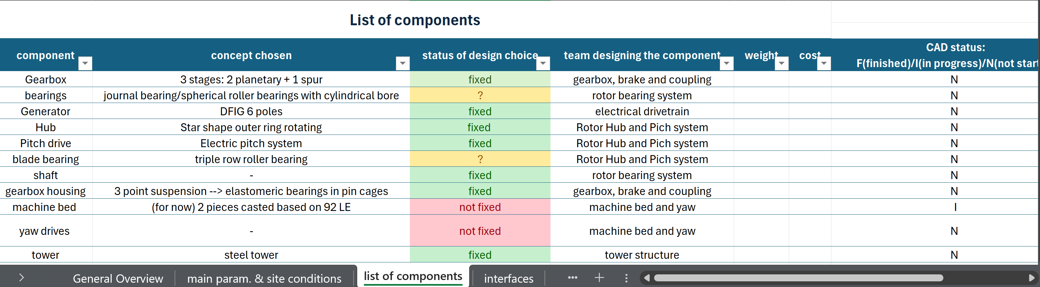
6. Questions and Requests
Figure 4: Screenshot of the result file in excel
You will find the list here: result file.xlsx
Luis Urhahn

Slide 13
Bibliography – Project Development
[1] Google, Google Maps. [Online]. Available: https://maps.google.com
[2] Google, Google Earth. [Online]. Available: https://earth.google.com/web/search/34%c2%b041%2749.6%22N+36%c2%b030%2730.0%22E/@34.67531382,36.5980701,506.39690821a,3513.70885844d,35y,360h,0t,0r/data=CiwiJgokCTkQ2iOXWkFAEQndzvkBWEFAGYw3RwMnREJAIQJ6D_SHPUJAQgIIAUICCABKCAjMjOyYBRAA
[3] Global Wind Atlas, Global Wind Atlas. [Online]. Available: https://globalwindatlas.info/en/.
[4] Open Infrastructure Map, OpenInfraMap. [Online]. Available: https://openinframap.org/#10.04/33.2058/36.2058.
[5] Shared files from the contact of Laurence Alhrshy. [Documets]
[6] Weibull distribution function and wind power statistics, ResearchGate. [Online]. Available: https://www.researchgate.net/publication/234452780_The_Weibull_distribution_function_and_wind_power_statistics
[7] „Introduction to wind turbine aerodynamics“, Alois Peter Schaffarczyk [online book].
[8] WindPro, University License for WindPro [Software]
[9] QGIS, Public Software of QGIS [Software]
Luis Urhahn

